Slide 2
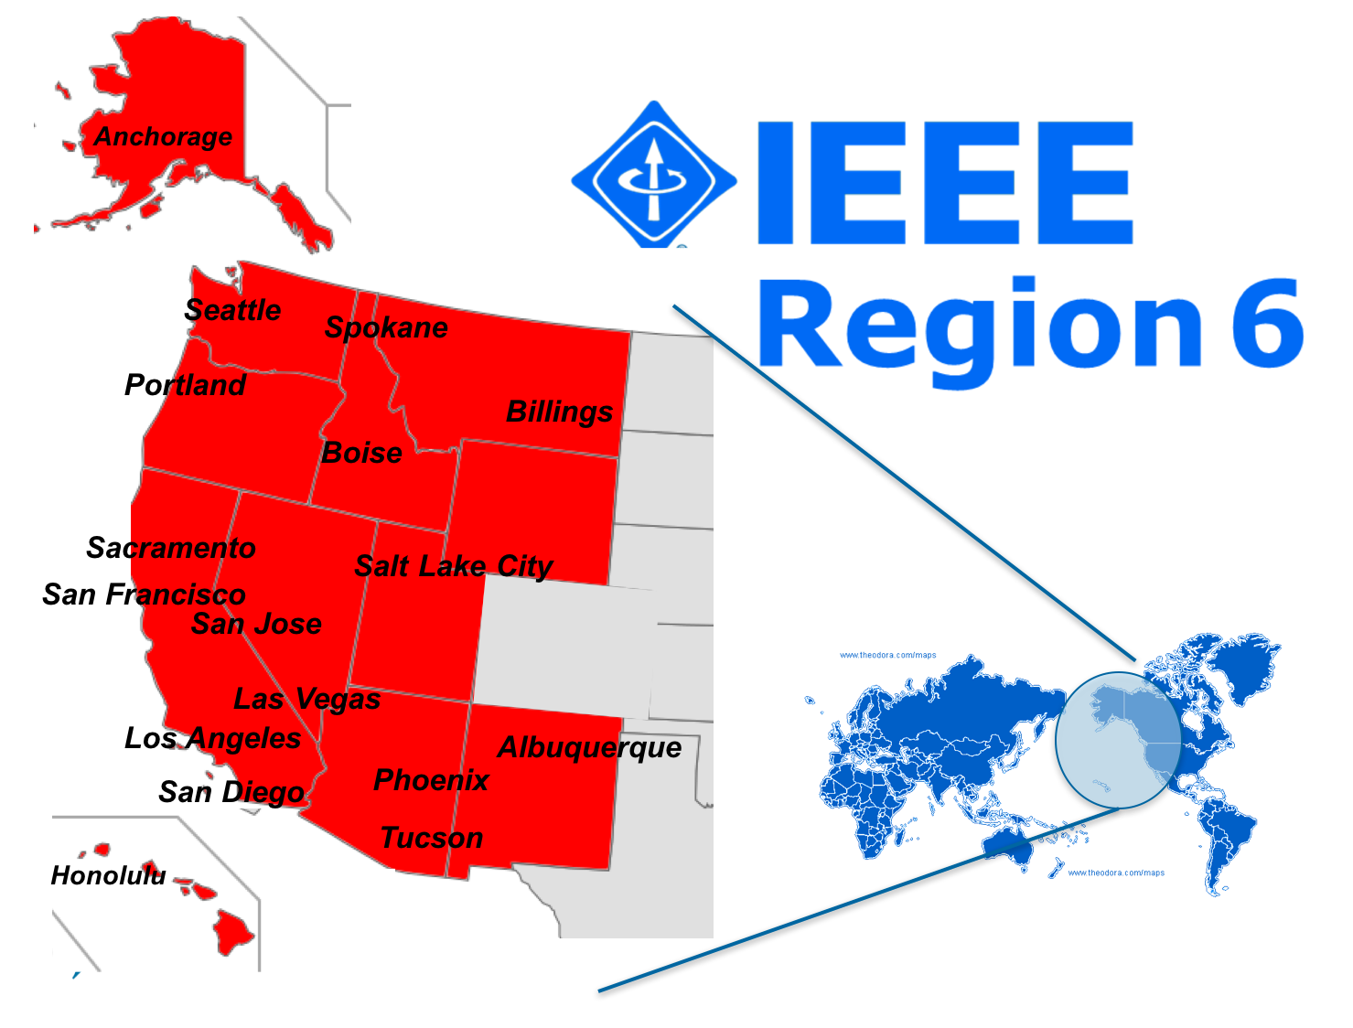
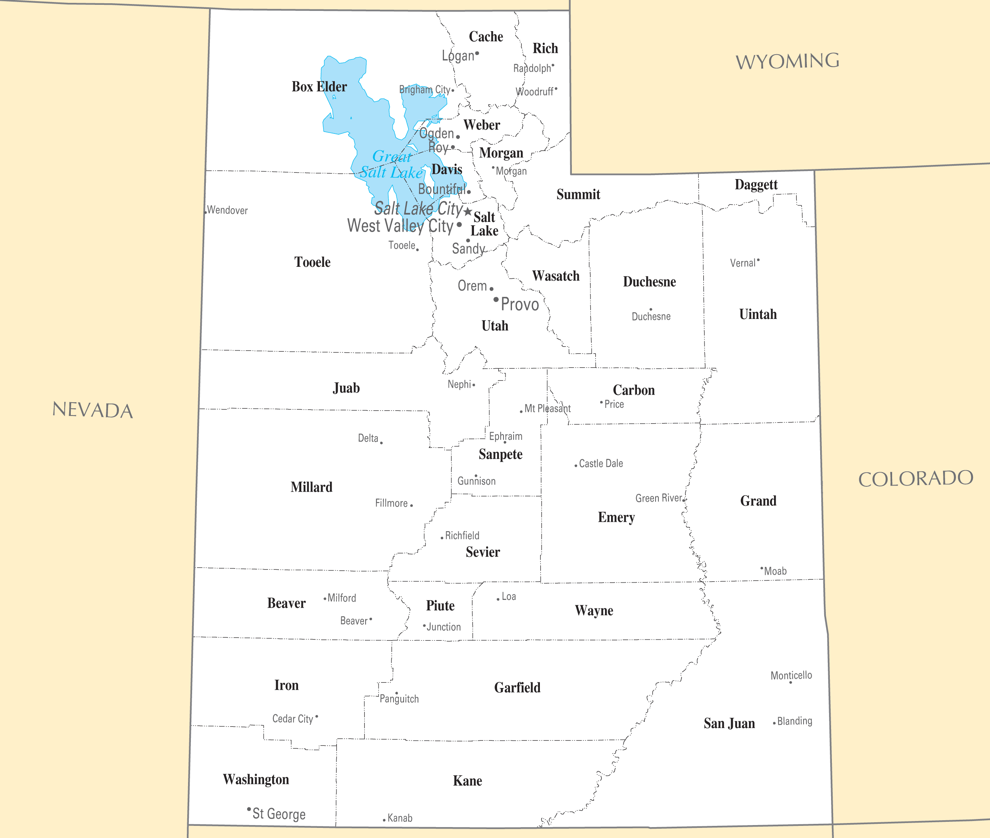
Utah Section – Joint APS/EMC Chapter
The Utah section is the entire state, with most membership along the Wasatch Front

Slide 3
Utah Section – Joint APS/EMC Chapter
Brand New Chapter
Effective Date of Chapter formation is March 11, 2021
Joint Chapter with APS
Current membership
EMC – 11
APS – 34

Slide 4
Utah Section – Joint APS/EMC Chapter
First Official Meeting May 12, 2021
Elected officers
Chair: Randy J. Jost
Vice Chair: Cynthia Furse
Treasurer: John Rohrbaugh
Several technical meetings already held, including joint meetings with Denver chapter, latest planned for August 2, 2021
Planning for a total of 5 + technical meetings by the end of the calendar year

Slide 5
Utah Section – Joint APS/EMC Chapter
Chapter Goals
Support the professional growth of members and facilitate the growth and success of their employers
Focus on educational outreach
Provide a reservoir of relevant knowledge for members, section and community at large

Slide 6
Utah Section – Joint APS/EMC Chapter
Best Practices for Chapter Success
Personally reach out to members.
Asking for volunteers will net many respondents, if lucky.
Asking specific individuals to participate, and providing support, will net much more success.
Use all your resources
While obvious, will only succeed if you KNOW what your resources are, i.e. have you done a resource inventory lately?
Articulate what the benefits of participation are for others, and remind them periodically.

